Slide 1
MOOSE– Massively Object-Oriented Simulation Environment
the multiphysics framework

Slide 2
MOOSE Physics Modules
Chemical Reactions Contact External PETSc Solver Fluid Properties Function Expansion Tools Heat Conduction Level Set Navier Stokes Phase Field Porous Flow rDG Stochastic Tools Tensor (solid) Mechanics XFEM Shallow Water (work in progress) Ray Tracing (work in progress)

Slide 4
Governing Equations

Slide 5
Input Files

Slide 6
Input File

Slide 8
Run Example via Command Line

Slide 9
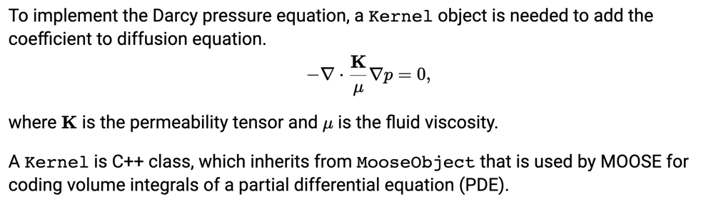
Kernel

Slide 10
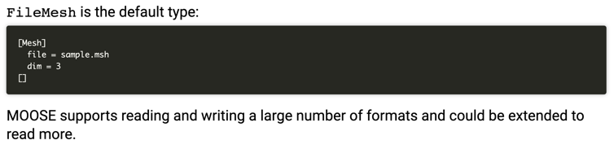
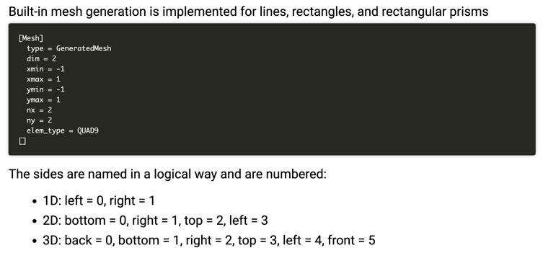
Mesh

Slide 11
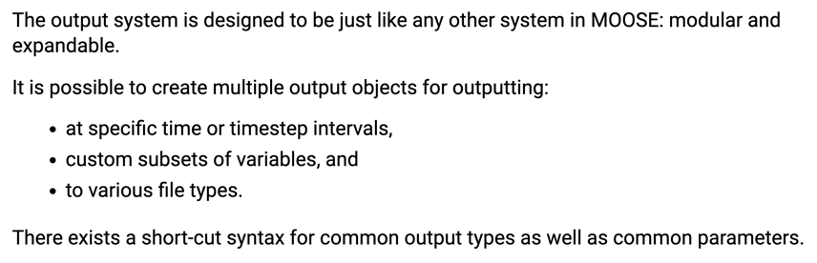
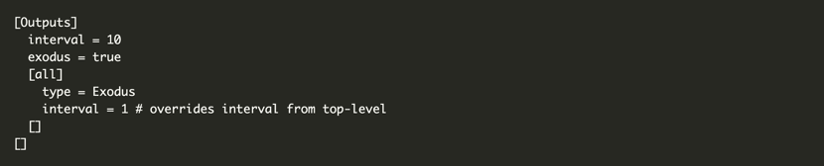
Outputs

Slide 12
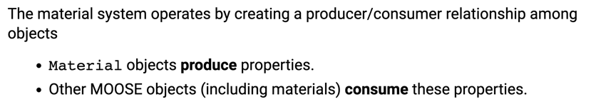
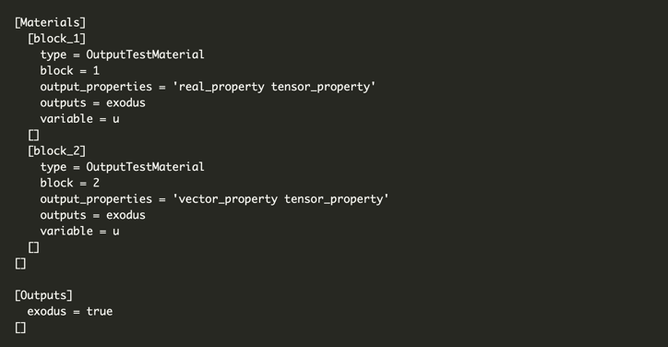
Materials

Slide 13
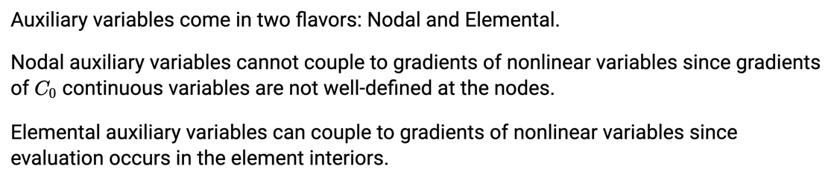
Auxiliary Variables

Slide 16
Visualization
Two ways to visualize
Peacock: MOOSE GUI
Paraview: External software program that can read exodus files
I recommend downloading paraview
It is free and open source
Very flexible
Less buggy than peacock

Slide 17
Paraview
Open new
Move forward in time
Select Properties

Slide 19
MOOSE C++ Fundamentals
Will not cover here, if you feel like you need some background, go to below site, where they have some basics
https://mooseframework.org/workshop/#/10

Slide 20
MOOSE Solve Types

